Slide 1
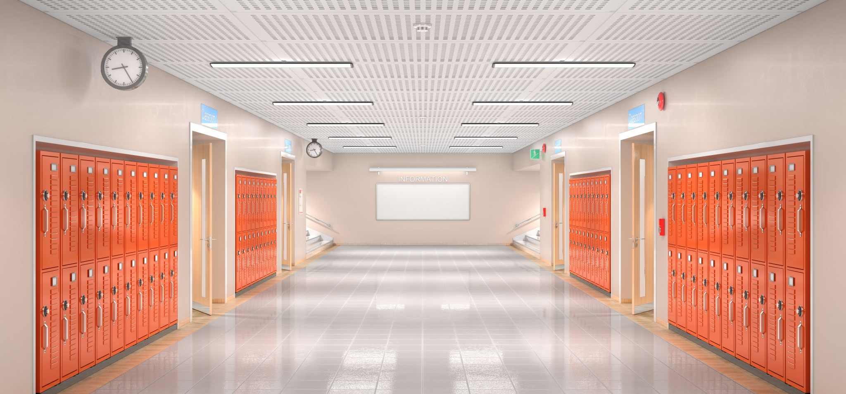
H&S Ventilation and Safety in Schools
Understanding your workplace rights
Knowing the legislation and the guidance
Building a safer school environment

Slide 2
Introduction
This session is aimed at helping school Reps to understand the H&S guidance around ventilation of schools in the context of working in the Covid-19 Pandemic.
We will discuss implications and implementation of the guidance, legislation, and remedies.
Understand the importance of collective response and trade union participation to underpin a safe working environment

Slide 3
Legislation
It is very important to remember that there has been legislation covering H&S in situ for many years specifically covering the matter of ventilation in schools and surrounding matters.
Do not be turned off by the fact that legislation sounds boring! Whilst it may not be a panacea for all H&S ills it gives you rights and legal recourse to ensuring that standards are met and maintained. It exists to bring those into line who do not meet these legal requirements.
H&S Reps will be trained to be well versed in knowing the type of legislation that exists and are key to ensuring compliance. Get a School H&S Rep!
In the context on Covid and ventilation the most relevant pieces are:

Slide 4
The Health And Safety At Work Act 1974, And Associated Regulations
It is of vital importance that you are consulted as to the robustness and effectiveness of the updated risk assessment and ensuing plan.
This updated risk assessment must be completed in the context of the revised guidance and return to full time education in schools. Your school rep must be consulted on the
updated risk assessment prior to implementation. Your school rep should also facilitate branch consultation via a school meeting.

Slide 5
The Workplace (Health, Safety And Welfare) Regulation 1992
Regulation 6 – Ventilation states:
“(1) Effective and suitable provision shall be made to ensure that every enclosed
workplace is ventilated by a sufficient quantity of fresh or purified air.
(2) Any plant used for the purpose of complying with paragraph (1) shall include an
effective device to give visible or audible warning of any failure of the plant where necessary for reasons of health or safety.”
The ACOP guidance includes the following points:
Air that is introduced should, as far as possible, be free of any impurity, which is likely to be offensive or cause ill health. Where necessary, the inlet air should be filtered to remove particulates.
Where necessary, mechanical ventilation systems should be provided to part or all of the building.
Occupants should not be exposed to uncomfortable draughts.
The fresh air supply rate should not normally fall below 5 to 8 litres per second, per occupant.

Slide 6
The Workplace (Health, Safety And Welfare) Regulation 1992
Regulation 7 on Temperature requires that during working hours, the temperature:
shall be reasonable; and that excessive effects of sunlight on temperature shall be avoided.
During working hours, the temperature in all workplaces inside buildings shall be reasonable.
(2) A method of heating or cooling shall not be used which results in the escape into a workplace of fumes, gas or vapour of such character and to such extent that they are likely to be injurious or offensive to any person.
(3) A sufficient number of thermometers shall be provided to enable persons at work to determine the temperature in any workplace inside a building.

Slide 7
Cont’d
requires that temperatures shall be “reasonable” and the accompanying Approved Code of Practice defines this as “normally at least 16°C” (60°F) (para 43) during “the length of time people are likely to be there” (para 49).
The School Premises (General Requirements and Standards) (Scotland) Regulations 1967 includes provisions for minimum temperatures in different areas within schools. They are on Page 52 of the EIS Health and Safety Handbook.

Slide 8
The Management Of Health And Safety At Work Regulations 1999 (The Management Regulations).
state that -
your employer is obliged to provide you with a safe place of work through the
use of a risk assessment.
A risk assessment will allow you to identify hazards and risk factors that have the potential to cause harm.
There are five steps in a risk assessment:
• Identify the hazards
• Decide who might be harmed and how
• Evaluate the risks and decide on precautions
• Record your significant findings
• Review your assessment and update if necessary
Because Regulation 3 Covers The Whole Cottage Industry Of Risk Assessment.

Slide 9
Ventilation - Introduction
Why is ventilation so important?
Risk assessment and ventilation?
Have the existing risk assessments been updated in line with the revised CERG guidance?
Are heating & ventilation included in the revised risk assessments?
Aerosol Transmission
Notes:
Like “thermal comfort” everyone has their own level of room ventilation that they are comfortable with. Most will likely simply open your windows to let fresh air in and then having to close them again when the room temperature drops.
Whichever method you use, adequate ventilation in a classroom is always important. However, during the current pandemic, (and possible future epidemics), it is one of the main “mitigations” to reduce transmission of the coronavirus.
Good ventilation is a balance between making sure classrooms are warm but keeping a flow of air going through an area.
Why is ventilation so important?
Covid can spread from an infected person’s mouth or nose in small liquid particles when they cough, sneeze, speak, sing or breathe. These particles range from larger respiratory droplets to smaller aerosols. Current evidence suggests that the virus spreads mainly between people who are in close contact with each other, typically within 1 metre (short-range). A person can be infected when aerosols or droplets containing the virus are inhaled or come directly into contact with the eyes, nose, or mouth. The virus can spread in settings where people tend to spend longer periods of time. This is because aerosols remain suspended in the air or travel farther than 1 metre (long-range).
Ventilation is the process of replacing stale air with fresh air. Effective ventilation removes stale air which may contain Covid-19 aerosols and brings in fresh air containing more oxygen, less carbon dioxide (CO₂) and water vapour and fewer microbes. Achieving good ventilation is all about understanding ventilation systems in the workplace and checking how well they are performing in removing stale air and bringing in fresh air. Ventilation systems can be natural, with fresh air coming through open windows, doors or air vents, or mechanical, with fans and ducts bringing in fresh air from outside.
Risk assessment and ventilation?
To ensure that the importance of ventilation is understood, and effective ventilation achieved, a collaborative approach should be adopted by management and members using the risk assessment process. It is important that heating and ventilation are included in a risk assessment and the breadth and depth of examining these issues are informed by the latest CERG guidance.
A revised risk assessment checklist for ventilation and heating can be accessed on the EIS website.

Slide 10
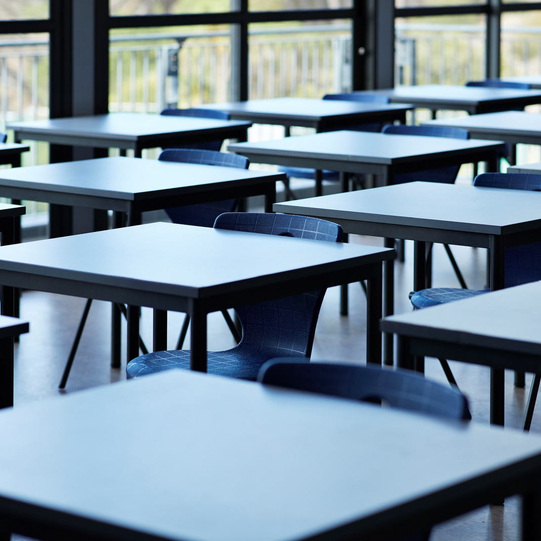
Ventilation - Identifying Poorly Ventilated Areas And Using CO2 Monitors
The presence of natural ventilation such as open windows, doors, or vents?
The presence of mechanical systems providing outdoor air, temperature control, or both?
Areas that feel stuffy or smell bad?
CO2 monitors?
How to get the most accurate readings
How the measurements can help you take action
Notes:
There are some simple ways to identify poorly ventilated areas:
Look for areas where people work and where there is no mechanical ventilation or natural ventilation such as open windows, doors, or vents
Check that mechanical systems provide outdoor air, temperature control, or both. If a system only recirculates air and has no outdoor air supply, the area is likely to be poorly ventilated
Identify areas that feel stuffy or smell bad
CO2 Monitors
People exhale carbon dioxide (CO2) when they breathe out. If there is a build-up of CO2 in an area it can indicate that ventilation needs improving.
Although CO2 levels are not a direct measure of possible exposure to COVID-19, checking levels using a monitor can help you identify poorly ventilated areas and increased aerosol transmission.
Different local authorities will have different approaches to monitoring CO2 levels. There are both mobile and fixed monitors and different makes of monitors with a range of enhancements and features. However, it is important that you are clear on what has been agreed at your local level, as to the role and responsibilities of individuals within your school. Your local association secretary will be able to clarify this. However, there are some generic principles that should be understood at school level to help inform risk assessments.
Local authorities and other providers should ensure the information they gather as a result of these CO2 assessments is used to inform actions to improve ventilation in schools where required. This may include, for example:
Remedial works where appropriate (e.g. accelerated maintenance to remedy windows that will not open or faulty ventilation).
Providing further guidance to users (e.g. on regular opening of windows, etc..).
How to get the most accurate readings
Instantaneous or ‘snapshot’ CO2 readings can be misleading, so you should take several measurements throughout the day frequently enough to represent changes in use of the room or space. Then calculate an average value for the occupied period. In larger spaces it is likely that more than one sampling location will be required
Take measurements at key times throughout the working day and for a minimum of one full working day to ensure your readings represent normal use and occupancy
Record CO2 readings, number of occupants, the type of ventilation you’re using at the time and the date. These numbers will help you use the CO2 records to decide if an area is poorly ventilated
How the measurements can help you take action
The amount of CO2 in the air is measured in parts per million (ppm). CO2 measurements should be used as a broad guide to ventilation within a space rather than treating them as ’safe thresholds’.
Outdoor levels are around 400ppm and indoors a consistent CO2 value less than 800ppm is likely to indicate that a space is well ventilated.
An average of 1500ppm CO2 concentration over the occupied period in a space is an indicator of poor ventilation. You should take action to improve ventilation where CO2 readings are consistently higher than 1500ppm.
However, where there is continuous talking or singing, or high levels of physical activity (such as dancing, playing sport or exercising), providing ventilation sufficient to keep CO2 levels below 800ppm is recommended.

Slide 11
Ventilation - Assessment Of Fresh Air (Ventilation) In The Workplace
How many people use or occupy the area? The more people who use or occupy an area, the greater the risk that an infected person is there, increasing possible exposure to aerosol transmission.
How large is the area? The larger the area, the lower the risk.
What tasks or activities take place in the area? Activities that make you breathe deeper, for example physical exertion or shouting, will increase generation of aerosols and risk of transmission. Can some activities be moved outside or working alone where possible?
Are there any features in the workplace that affect ventilation, e.g., large machinery, equipment, etc.?
Do you use desk or ceiling fans? These shouldn’t be used in poorly ventilated areas.
Do any areas feel stuffy or smell unpleasant?
Are there any areas of the premises without either natural ventilation, or mechanical ventilation?
Notes:
There are several factors to consider when deciding on the ventilation needed in your work areas.
You must make sure there is an adequate supply of fresh air in any workspace. You can do this by using:
natural ventilation - fresh air comes in through open windows, doors or air vents.
mechanical ventilation - fans and ducts bring in fresh air from outside
There may already be different types of ventilation around your workplace. It may help to make a list of areas in your workplace and how they are ventilated. Floor or design plans may help with this.
Alternatively, you could walk around the building and make a note of each area and how it is ventilated. Remember to include changing rooms and areas used for breaks, such as canteens. If you can’t tell easily how an area is ventilated, it may be because it is poorly ventilated.
When assessing ventilation in the workplace, the following should be considered.
How many people use or occupy the area? The more people who use or occupy an area, the greater the risk that an infected person is there, increasing possible exposure to aerosol transmission.
How large is the area? The larger the area, the lower the risk.
What tasks or activities take place in the area? Activities that make you breathe deeper, for example physical exertion or shouting, will increase generation of aerosols and risk of transmission. Can some activities be moved outside or working alone where possible?
Are there any features in the workplace that affect ventilation, e.g. large machinery, equipment, etc.?
Do you use desk or ceiling fans? These shouldn’t be used in poorly ventilated areas.
Do any areas feel stuffy or smell unpleasant?
Are there any areas of the premises without either natural ventilation, or mechanical ventilation?

Slide 12
Ventilation - Assessment Of Fresh Air (Ventilation) in the Workplace
Are any airbricks blocked?
Do windows open to allow fresh air to enter the workspace?
Do ventilation grids appear dirty?
Are ventilation facilities blocked by furniture or curtains?
Are draughts avoided for those seated near windows and doors?
Do mechanical ventilation systems provide outdoor air, temperature control, or both? If a system only recirculates air and has no outdoor air supply, the area is likely to be poorly ventilated.
Notes:
Are any airbricks blocked?
Do windows open to allow fresh air to enter the workspace?
Do ventilation grids appear dirty?
Are ventilation facilities blocked by furniture or curtains?
Are draughts avoided for those seated near windows and doors?
Do mechanical ventilation systems provide outdoor air, temperature control, or both? If a system only recirculates air and has no outdoor air supply, the area is likely to be poorly ventilated.

Slide 13
Ventilation - Improving Natural Ventilation
Purging (airing rooms)
1
Natural ventilation
Mechanical ventilation
Talking to members about improving ventilation
2
Notes:
You can improve natural ventilation by fully or partly opening windows, air vents and doors., but don’t prop fire doors open.
Buildings are usually designed to provide adequate ventilation and you should be able to open any windows or vents that let in fresh air. If they cannot be opened, ventilation in that area will be less effective.
If you identify an area that needs improvement, you should decide if it’s safe for people to use that area before anyone makes any changes to it. A maximum capacity should be introduced for smaller rooms to ensure greater dilution – this may mean reducing numbers of students in smaller classrooms. Note that halving occupancy is equivalent to doubling the ventilation rate. Some poorly ventilated areas of the premises may need to be restricted to single occupancy, or very short durations, or put out of use until ventilation is improved.
Purging (airing rooms)
Airing rooms as frequently as you can improves ventilation. Opening all the doors and windows ahead of the start of the working day maximises ventilation in a room. Classrooms and other areas should be ventilated properly between classes and uses, including at breaks and at lunchtime. This is one of the most important measures to ensure effective ventilation and involves opening windows fully for a short period of time. Subjecting rooms to periods of no occupancy also allows contaminants to dissipate. Cooler, windier weather increases natural ventilation through openings. This means you don’t need to open windows and doors so wide.
Where mechanical ventilation systems are in place, ventilation should start ahead of the working day and continue after classes have finished as cleaners and other maintenance staff will be working in those rooms. Air handling units should be set to maximise outdoor air over recirculated air. Rooms should be cleaned regularly to reduce recirculation of any virus deposited on surfaces and absorbed on dust.
Talking to your members about improving ventilation
Making sure that an area has enough fresh air relies on members playing their part. Contacting members and explaining the importance of adequate ventilation can allow them to play their part in reducing the risk of coronavirus (COVID-19) transmission.

Slide 14
Ventilation – How To Improve Mechanical Ventilation (Including Air Conditioning)
Maximising fresh air
Recirculating air
Notes:
Mechanical ventilation brings fresh air into a building from outside.
Maximising fresh air
Mechanical systems will provide adequate ventilation if they are set to maximise fresh air and minimise recirculation.
If your system draws in fresh air, it can continue to operate. On occasions, you may need to increase the rate or supplement it with natural ventilation (for example, by opening doors, windows or air vents) where possible.
Consideration could also be given to extending the operating times of mechanical ventilation systems to before and after people use work areas.
Recirculating air
Recirculation units (including air conditioning) can mask poor ventilation as they only make an area feel more comfortable. It’s better not to recirculate air from one space to another. Recirculation units for heating and cooling that do not draw in a supply of fresh air can remain in operation as long as there is a supply of outdoor air. This could mean leaving windows and doors open.

Slide 15
Ventilation - Balancing Ventilation with Keeping Workplace Temperatures Comfortable
Regulation 7 of the Workplace Regs and School Premises (General Requirements and Standards) (Scotland) Regulations 1967
Assessment of heating requirements
Is the temperature above the regulatory minimum? (16C)
Is the temperature in workspaces regulated by thermostats?
Are reasonable room temperatures maintained by the heating system at all times during the working day?
Are sufficient numbers of thermometers provided?
Are temperatures regularly monitored?
Simple steps
windows and doors partially open
relax dress codes
fan convector heaters if the area is well ventilated
Notes:
Providing adequate ventilation does not mean people have to work in an uncomfortably chilly or cold workplace.
Regulation 7 of the Workplace Regs states that the ‘temperature in all workplaces inside buildings shall be reasonable during working hours.’ A ‘reasonable temperature’ is defined in the accompanying ACoP as ‘that which provides reasonable comfort without special clothing and should normally be at least 16ºC or at least 13ºC where much of the work involves physical effort (such as repeated exertion to the extent that a temperature of 16ºC would be uncomfortably warm). The ACoP stipulates that where maintaining these standards are impractical then employers must take all reasonable steps to achieve a comfortable temperature as close to them as possible.
Once again, risk assessments should be able to determine the adequacy of heating requirements in schools. The following checkpoints could be utilised
Is the temperature above the regulatory minimum by 10am in the morning? (16oC)
Is the temperature in workspaces regulated by thermostats?
Are reasonable room temperatures maintained by the heating system at all times during the working day?
Are sufficient numbers of thermometers provided?
Are temperatures regularly monitored?
There are simple steps you can take to make sure your workplace is adequately ventilated without being too cold:
windows and doors partially open can still provide acceptable ventilation while keeping the workplace comfortable. Opening higher-level windows will probably create fewer draughts.
if the area is cold you could relax dress codes so people can wear extra layers and warmer clothing
You should only use fan convector heaters if the area is well ventilated.
A further consideration may be the need for higher heating settings to support greater ventilation and purging practices; and adjustments to timings where required.

Slide 16
Ventilation
Notes:
The following video can be accessed on YouTube and summarises the key principles of adequate ventilation with regard to Covid transmission.

Slide 17
What we should be looking out for on ventilation as part of a Risk Assessment
The law states there must be an adequate supply of fresh air in enclosed areas of the workplace always!
CO2 Monitors
Notable if 800ppm should not exceed 1500ppm
Air purges
Open high vents
Open doors
This control measure along with hygiene/ distancing/ masks should be identified in your RA
All Local Authorities should have had CO2 monitoring in place by start of October Break
Scotgov (July 21) “A greater emphasis must be plaved on ventilation” & “Employers should continue to consult TU’s”
RA’s are a legal Requirement incl any reasonable mitigations to reduce the spread of Covid-19
Notes:
The law states that there should be an adequate supply of air within enclosed spaces of the workplace. This is applicable whether dealing with Covid-19 or at any other time. Ventilation can be both natural and Mechanical.
Ventilation is part of a control measure that should be applied alongside all other current mitigations such as enhanced cleaning & hygiene protocols and this should be included in your RA which should be available to all staff for the purpose of 1. Identifying poorly ventilated areas 2. Assess risks of aerosol transmission 3. Take steps to improve ventilation.
There are ways to improve ventilation. Many of which you will already be doing incl air purges between classes, opening high windows or air vents and wedging open classroom doors (not fire doors unless they close automatically in an emergency & be subject to a review of the fire safety RA as per Scotgov Guidance)
Ventilation decreases the risk of aerosol transmission but not droplet (close contact) or contact (surfaces)
Remember ventilation must be balanced with maintaining an appropriate inside temperature – social behaviour changes in the winter months – Min temp 17 degrees celcius
CO2 monitors can be a good indication of whether natural ventilation from doors and windows is enough and all local Authorities should have access to monitors in place by the start Oct break as per Scotgov’s increased push on Ventilation mitigations.
If your room is regularly recording a reading of between 800ppm then adjustments need to be made, if you exceed 1500ppm consistently then action must be taken as a matter of urgency. If the adjustments do not suffice and appeals to management fall on deaf ears a more formal response will be required.
This is best done collectively as a whole branch to capture everyone’s experiences concurrently and creating space for all members to speak up.
After consulting with the branch, a response should be formulated in writing and agreed within the branch. Once agreed, the response should be presented to the SMT. In reality, this might have to happen quickly but try to consult as many branch members as possible.
In formulating a response, it is important to recognise that it is a consultation exercise and to be aware of the implications of this. It would be advisable to include, for each criticism of the risk assessment, counter control measures and the associated benefits that can be achieved.
Talk to the employer - It is important that management are aware of your expectations during this process and that arrangements are put in place for:
employees to have access to risk assessments, in different formats if required, and are able to challenge and question
a realistic timescale for the consultation process to occur and an agreed format for response
the Identification of employees at higher risk
recognition of Equalities issues
A recording and reviewing process – reviewed every three weeks, at least, in line with Scottish Government phasing advice

Slide 18
Responding To Health And Safety As An EIS Branch
Convene EIS branch meetings - regular dialogue with members is key
Establish a branch working group around H&S
Identify members concerns – Don’t wait until a situation is at it’s worst to take action.
Put branch concerns in writing to the HT
Update your LA Secretary
If concerns are not being addressed then raise a formal grievance
Raise a dispute-seek support of LA Secretary and Area Officer
Notes:
Conducting regular branch meetings at the moment will help all members stay connected and up to date with the latest information and provides an opportunity to share information/ issues. Branch meetings can take place in person in a suitable space or online to minimise physical contact between members or with the use of VC is you have vunderable members or those who live with shielding family. Meetings can be short and be a regular place to touch base.
Establish a H&S subgroup within your EIS branch- keeping on top of the latest information regarding H&S will allow the branch to move quicker on issues as they arise. It also helps to encourage more members to actively get involved in their trade union so that the work of a trade union is not seen as just something a rep is responsible for. Think about our campaign for better pay and the pay campaign branch committees we set up to raise the visibility of the EIS and members issues. Covid-19 is not going away anytime soon and Health and Safety is something we need to be organising around.
Identify members concerns- members need opportunities and spaces to be able to raise questions and concerns. Regular branch meetings help that. But it is important we map and identify what those concerns are so we can tackle them. Surveys are a quick and easy way to get feedback from EIS members in your schools. Will talk more on this in next slide.
Put concerns in writing- it is vital that there is written evidence of concerns that have been raised around H&S or any workplace matter. If issues are not taken seriously or resolved, then this forms part of the evidence that we need later in the process.
Update LA Sec- being able to respond to issues as a branch is crucial but also remember to update your LA Secretary about your concerns too so issues can also be mapped across the authority and raised at LNCT level.
Raising a formal grievance– if the issues raised by the branch have not been acknowledged and acted upon then members may want to take out a collective grievance. The grievance should be in writing and the basis of the grievance set out. Your LA Secretary should be informed and be able to support you at this stage.
Raising a dispute- if concrete steps have not been taken to address the grievance then members may want to move to a dispute. Your LA Secretary, Area Officer and Organiser will provide you with support as well as staff in our legal team.
At each step of this process it is crucial we are consulting and regularly communicating with all EIS members in our branch. These are concrete steps that you can take as a school rep with members of the EIS branch locally. Due to the place of change at the moment it is imperative that members are able to respond to concerns locally and with speed.

Slide 19
Building Evidence
Gathering concrete evidence of members concerns around health and safety will be central to challenging and addressing the issues.
Always put concerns in writing, make them clear and include your expected resolution
Keep a diary of steps taken by the rep and the branch
Verbal conversations should be followed up by a written summary of the discussions
Members’ surveys and feedback, forms the basis of concrete evidence and will strengthen your case
A collective petition signed by members of the branch highlights the collective sense of feeling
Visually document concerns where necessary
Notes:
Whether it be at school level, at LNCT or SNCT we need to ensure we are gathering evidence of members concerns in the right way.
Workers should have a work environment that will not rob them of their health or their lives and therefore all health and safety concerns must be taken seriously. But what concrete steps can we take to evidence members concerns?
Always raise health and safety concerns as soon as they are identified. As a school rep you will be the one to raise the concerns of EIS branch members. Ensure you put your concerns in writing and email your HT. It’s important that you also keep your LA Secretaries updated so further support if necessary, can be provided.
Try and keep a note of dates and details of any issues that are identified and addressed and dates of any correspondence with your senior management team on the issues.
Always ask for concerns to be addressed in writing. And any verbal communications exchanged over your concerns should then be summarised via an email outlining your conversation.
There is no such thing as an off the record conversation when it comes to members health and safety concerns. These must be taken seriously. Any breaches much be properly recorded and actioned.
Members surveys as mentioned in the previous slide are a good way of collecting evidence on members views. Use the evidence you have gathered in building your case for improved conditions in your workplace.
A quick way of highlighting members strength of feeling over a workplace issue is by asking members to sign a petition and presenting this to management. Not only does it build member participation but again provides concrete evidence of members concerns.
There may be occasions where you require visual photographic evidence of workplace health and safety breaches. Remember Health and Safety Reps have specific protections by law and ensuring you have elected branch H&S Reps helps ensure issues are dealt with quickly and properly.
Any evidence that you collect at school level could help strengthen a case later at LNCT or SNCT level.

Slide 20
Reference Links -
http://www.legislation.gov.uk/
https://www.eis.org.uk/Guidance-And-Information/ReduceCOVIDRisk
https://www.eis.org.uk/Health-And-Safety-Advice/SchoolHeating
https://www.gov.scot/publications/coronavirus-covid-19-guidance-on-reducing-the-risks-in-schools/
https://www.gov.uk/government/news/new-campaign-to-stop-covid-19-hanging-around

Slide 21
What are you Happy to Settle For?
We work in the environment we are happy to settle for.
Come together to bargain for more.
Organise together to settle only for your safety.
Notes:
Both the Scottish Government and the EIS have continued to reiterate that the school returns should be coordinated in consultation and with the full involvement of the trade unions at all levels.
The EIS has continued to represent you at all national forums and groups, including CERG and the workstreams involved. The outcomes of these national forums may not always reflect our expectations and views in their final conclusions. They are essential to get agreement but also to register our members best interest even where our contributions are not part of the outcome.
What is most important is how our structures, participation and knowledge is reflected at local level. It is how members react to supporting agreed practices but as importantly is how members deal with a lack of adequate measures in the workplace.

